Slide 1
Design And Implement A Bus Ticketing And Payment System Through Any Open Cloud Platform.
SlideMake.com

Slide 2
Introduction to the Bus Ticketing System
The bus ticketing system aims to simplify the process of purchasing tickets for travelers.
It serves as a digital platform that connects passengers with bus operators in real-time.
This system enhances customer experience while optimizing operational efficiency.
1
Notes:
Image source: https://www.researchgate.net/figure/Architecture-of-Online-Bus-Tracking-and-Ticketing-System_fig1_354523203

Slide 3
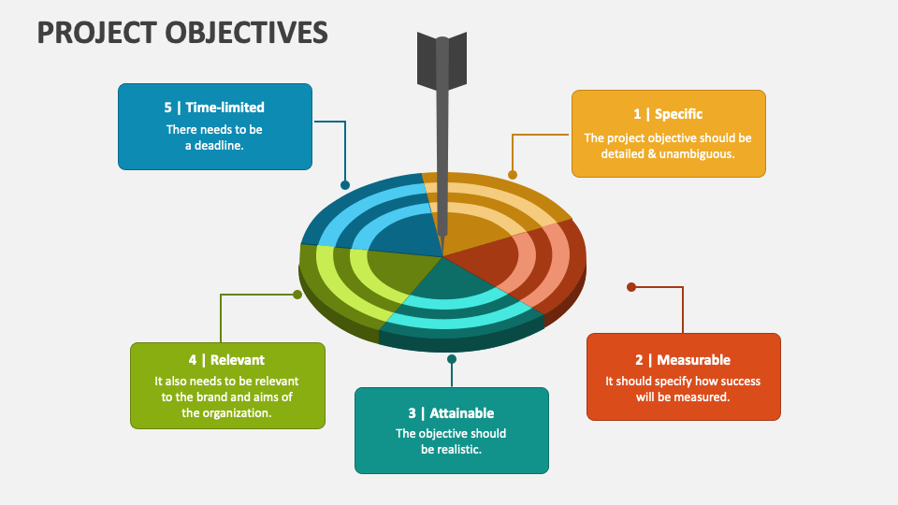
Objectives of the System
The primary objective is to provide an easy-to-use interface for ticket booking and payment.
It aims to reduce operational costs for bus operators by automating ticket sales.
The system seeks to improve customer satisfaction through better accessibility and convenience.
2
Notes:
Image source: https://www.collidu.com/presentation-project-objectives

Slide 4
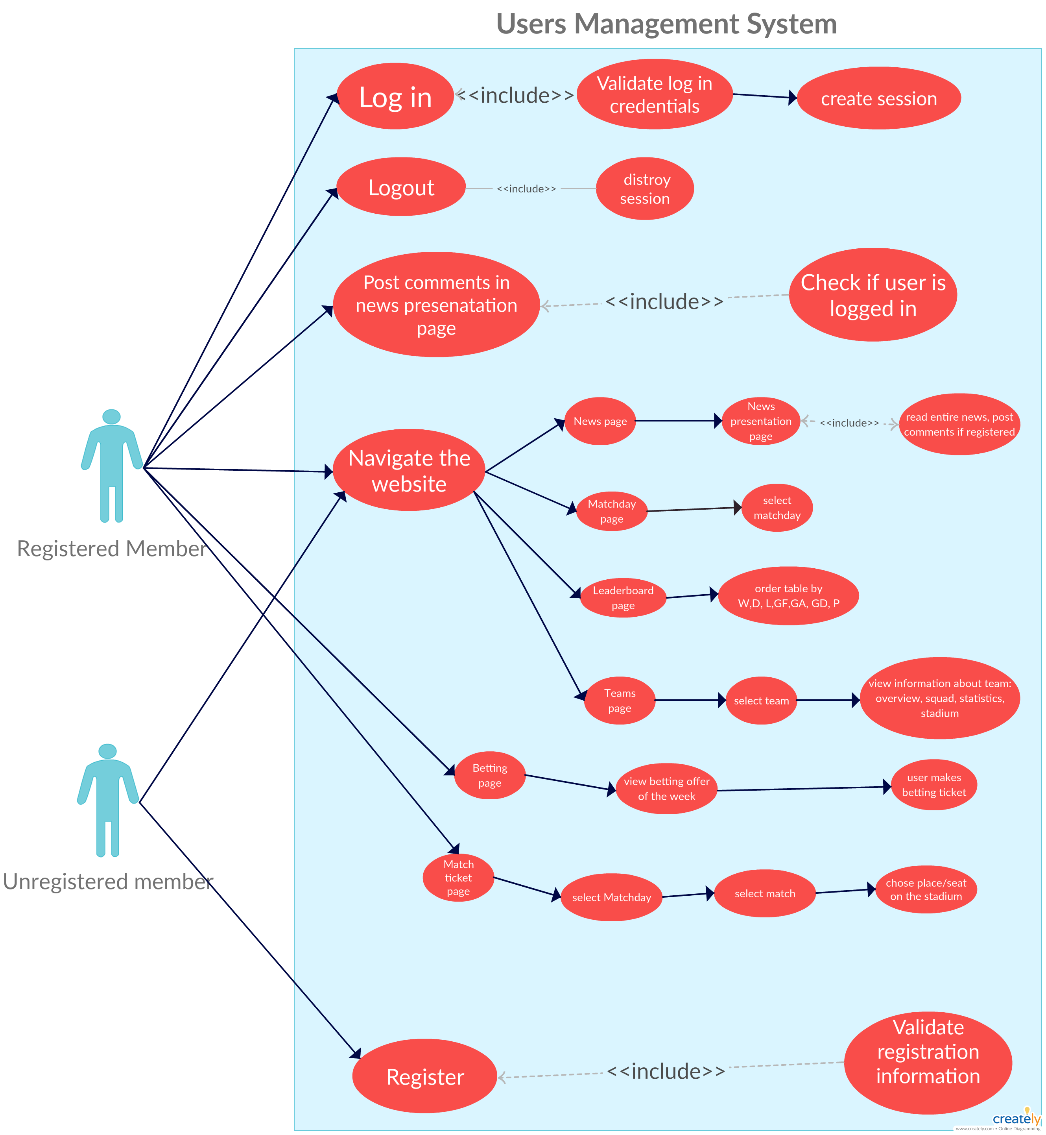
Key Features of the System
Users can search for routes, view schedules, and book tickets seamlessly.
The system includes multiple payment options for user convenience, including credit cards and e-wallets.
It provides real-time notifications about ticket confirmation and bus schedules.
3
Notes:
Image source: https://www.pinterest.ph/pin/use-case-diagram-of-users-management-system-this-diagram-shows-the-relationship-between-the-users-and-the-websit--5559199532785591/

Slide 5
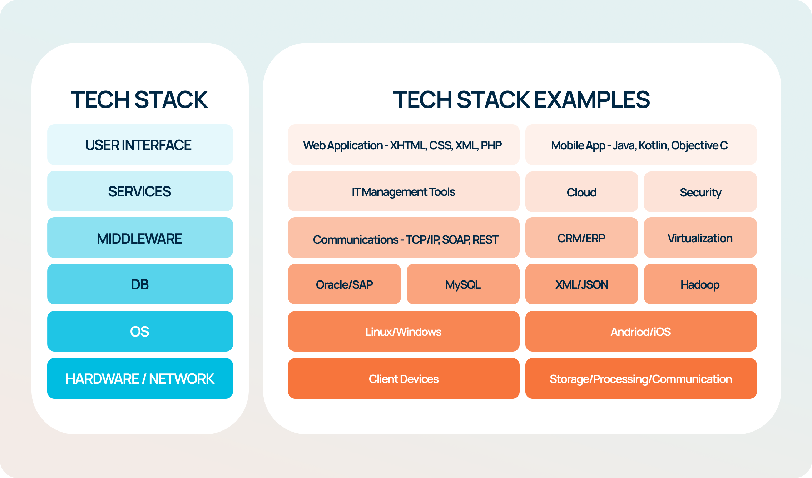
Technology Stack Overview
The system will be implemented using an open cloud platform such as AWS or Google Cloud.
Frontend technologies may include React or Angular for a responsive user interface.
The backend will utilize Node.js or Python with a database like MongoDB or PostgreSQL.
4
Notes:
Image source: https://old.sermitsiaq.ag/en/technology-stack-template.html

Slide 6
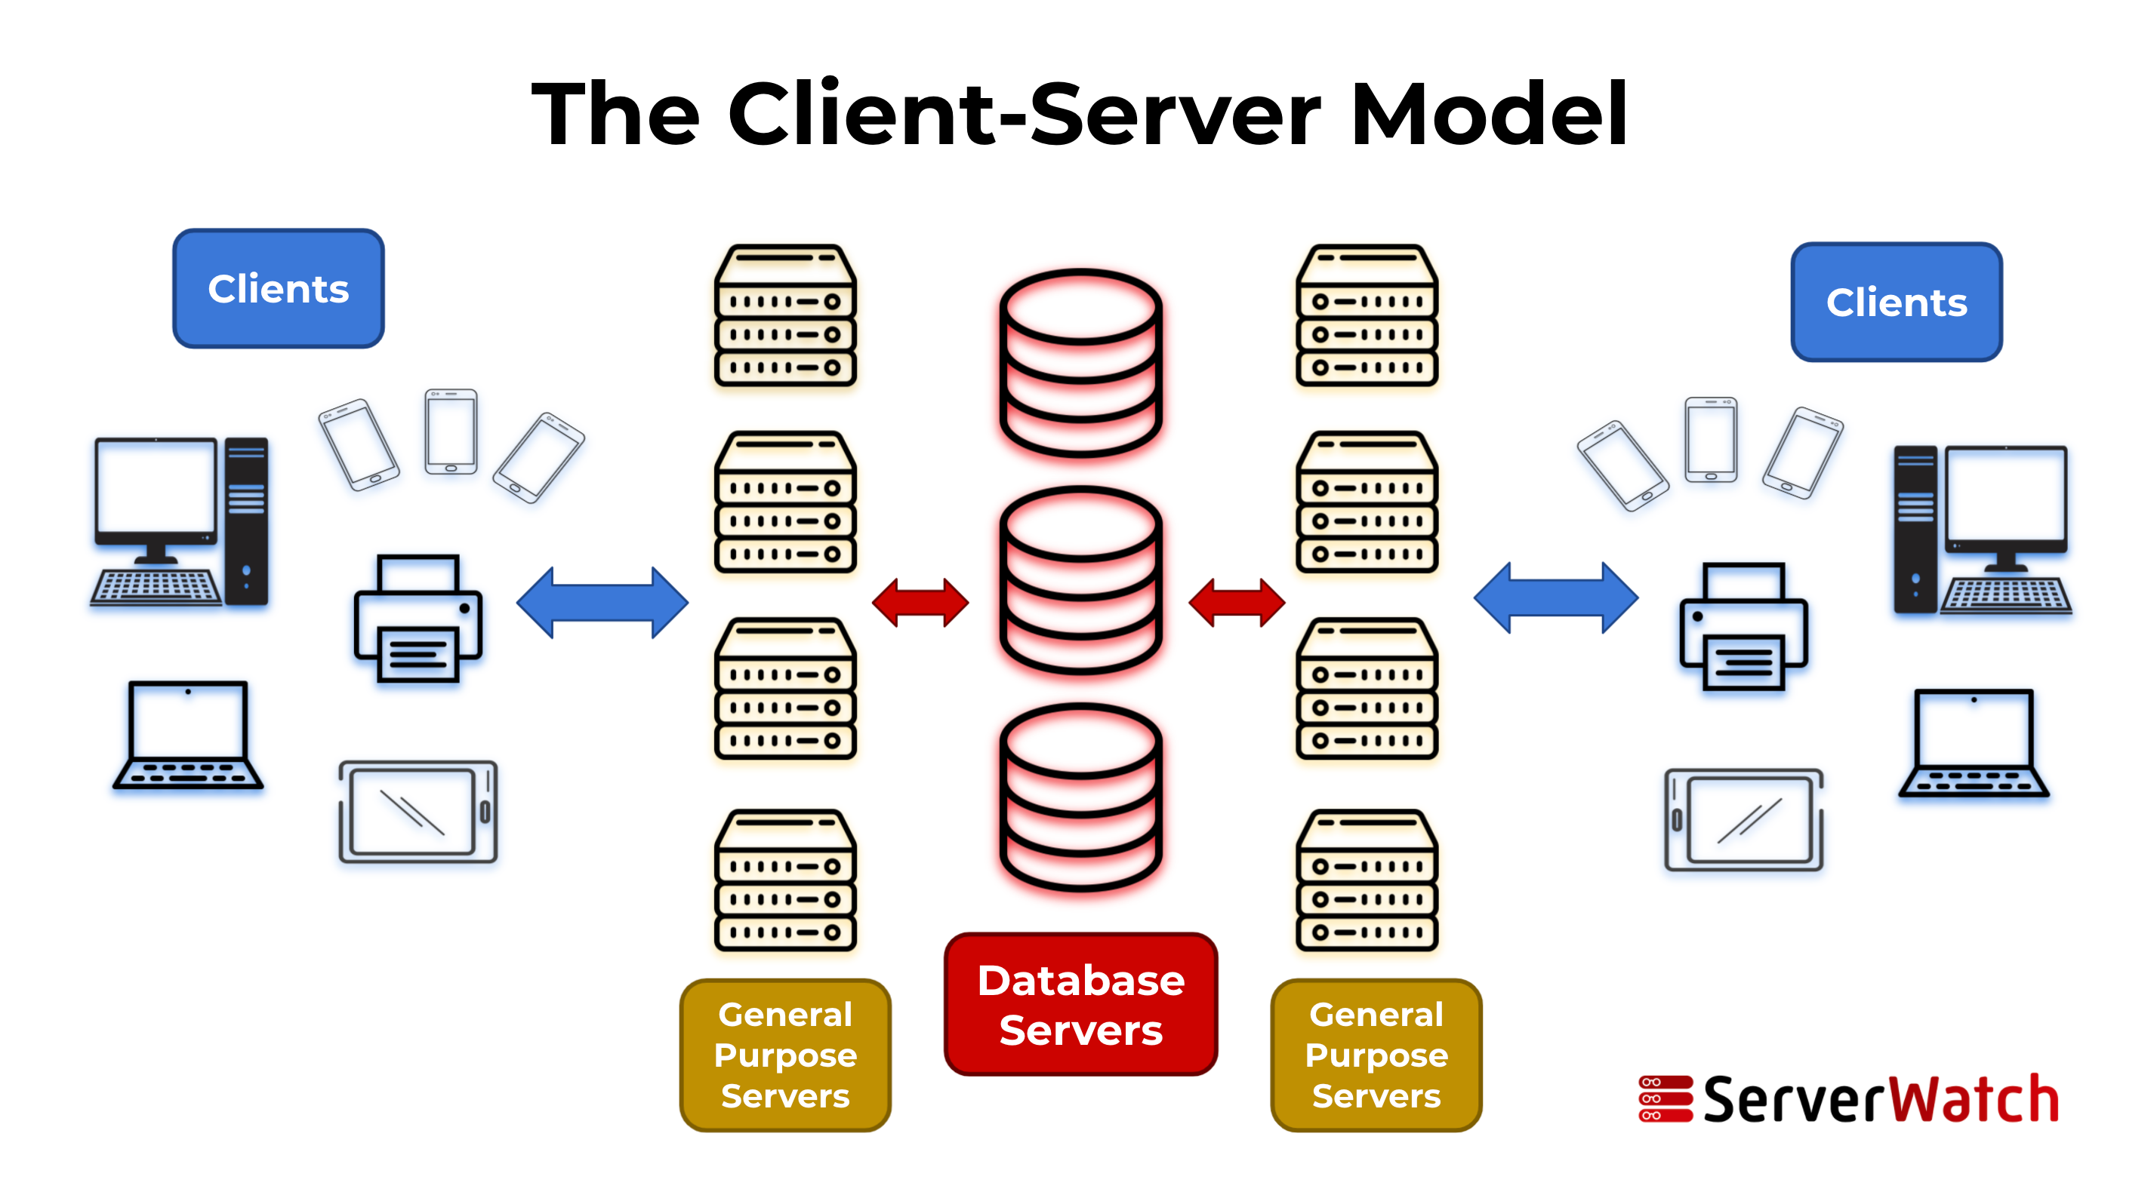
System Architecture
The architecture consists of a client-side application, server-side API, and a database.
Each component communicates through RESTful APIs to ensure modularity and scalability.
Cloud services like AWS Lambda can be utilized for serverless functions to enhance performance.
5
Notes:
Image source: https://www.serverwatch.com/guides/client-server-model/

Slide 7
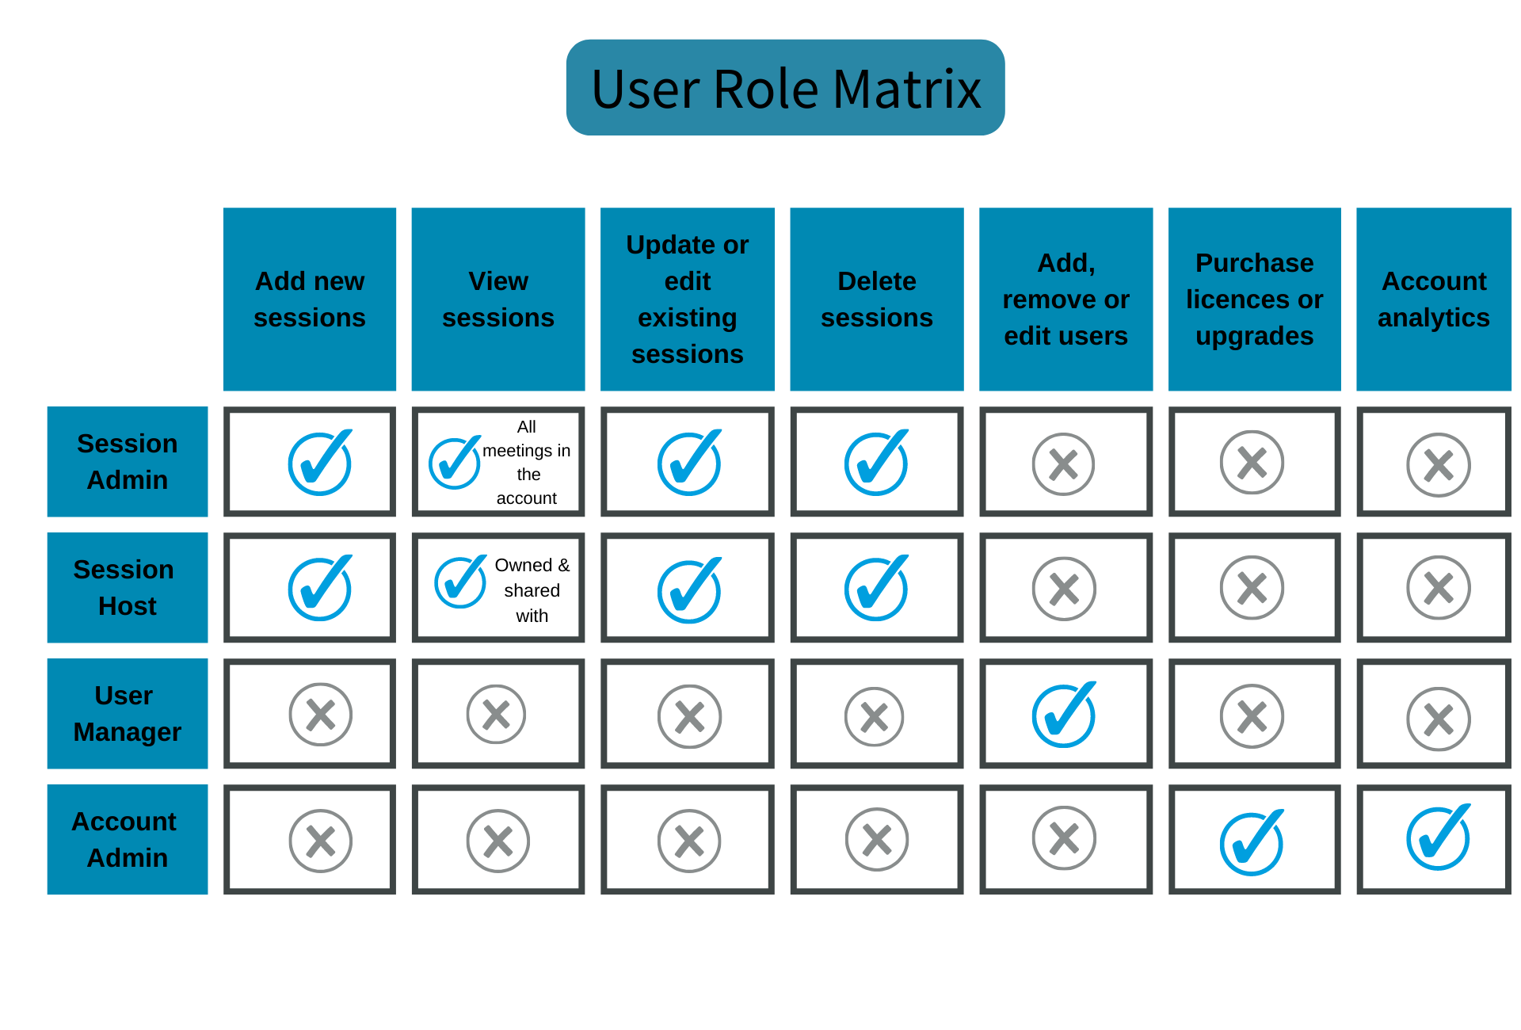
User Roles and Permissions
The system defines several user roles, including passengers, bus operators, and administrators.
Each role has specific permissions that govern access to various functionalities.
This role-based access control helps maintain security and manage user interactions effectively.
6
Notes:
Image source: https://help.vevox.com/hc/en-us/articles/360001352998-What-are-the-different-user-roles-and-permissions-in-Vevox-

Slide 8
Payment Integration
The payment module will integrate with payment gateways like Stripe or PayPal for transactions.
Security protocols including SSL encryption will be implemented to protect user data.
A simple and intuitive checkout process will enhance user experience while minimizing cart abandonment.
7
Notes:
Image source: https://www.codelessplatforms.com/connectors/stripe-payment-gateway-integration/

Slide 9
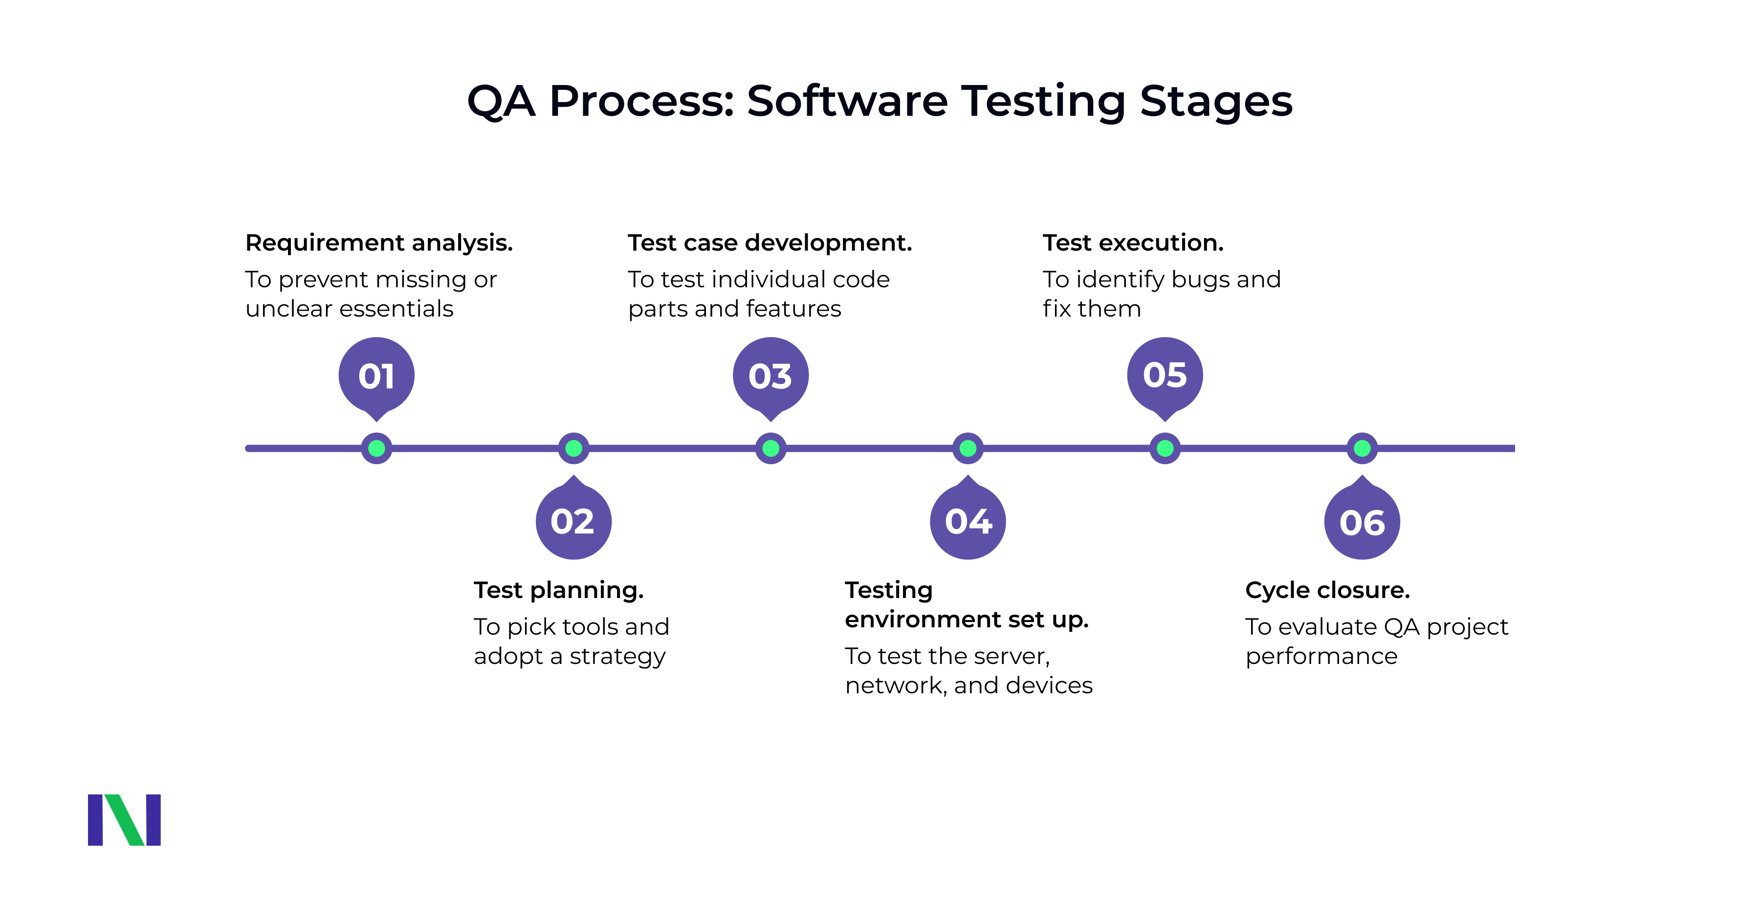
Testing and Quality Assurance
The system will undergo multiple testing phases including unit, integration, and user acceptance testing.
Automated testing tools will be used to ensure consistent performance and reliability.
Feedback from beta users will be collected to make necessary adjustments before launch.
8
Notes:
Image source: https://neklo.com/what-is-quality-assurance-testing/

Slide 10
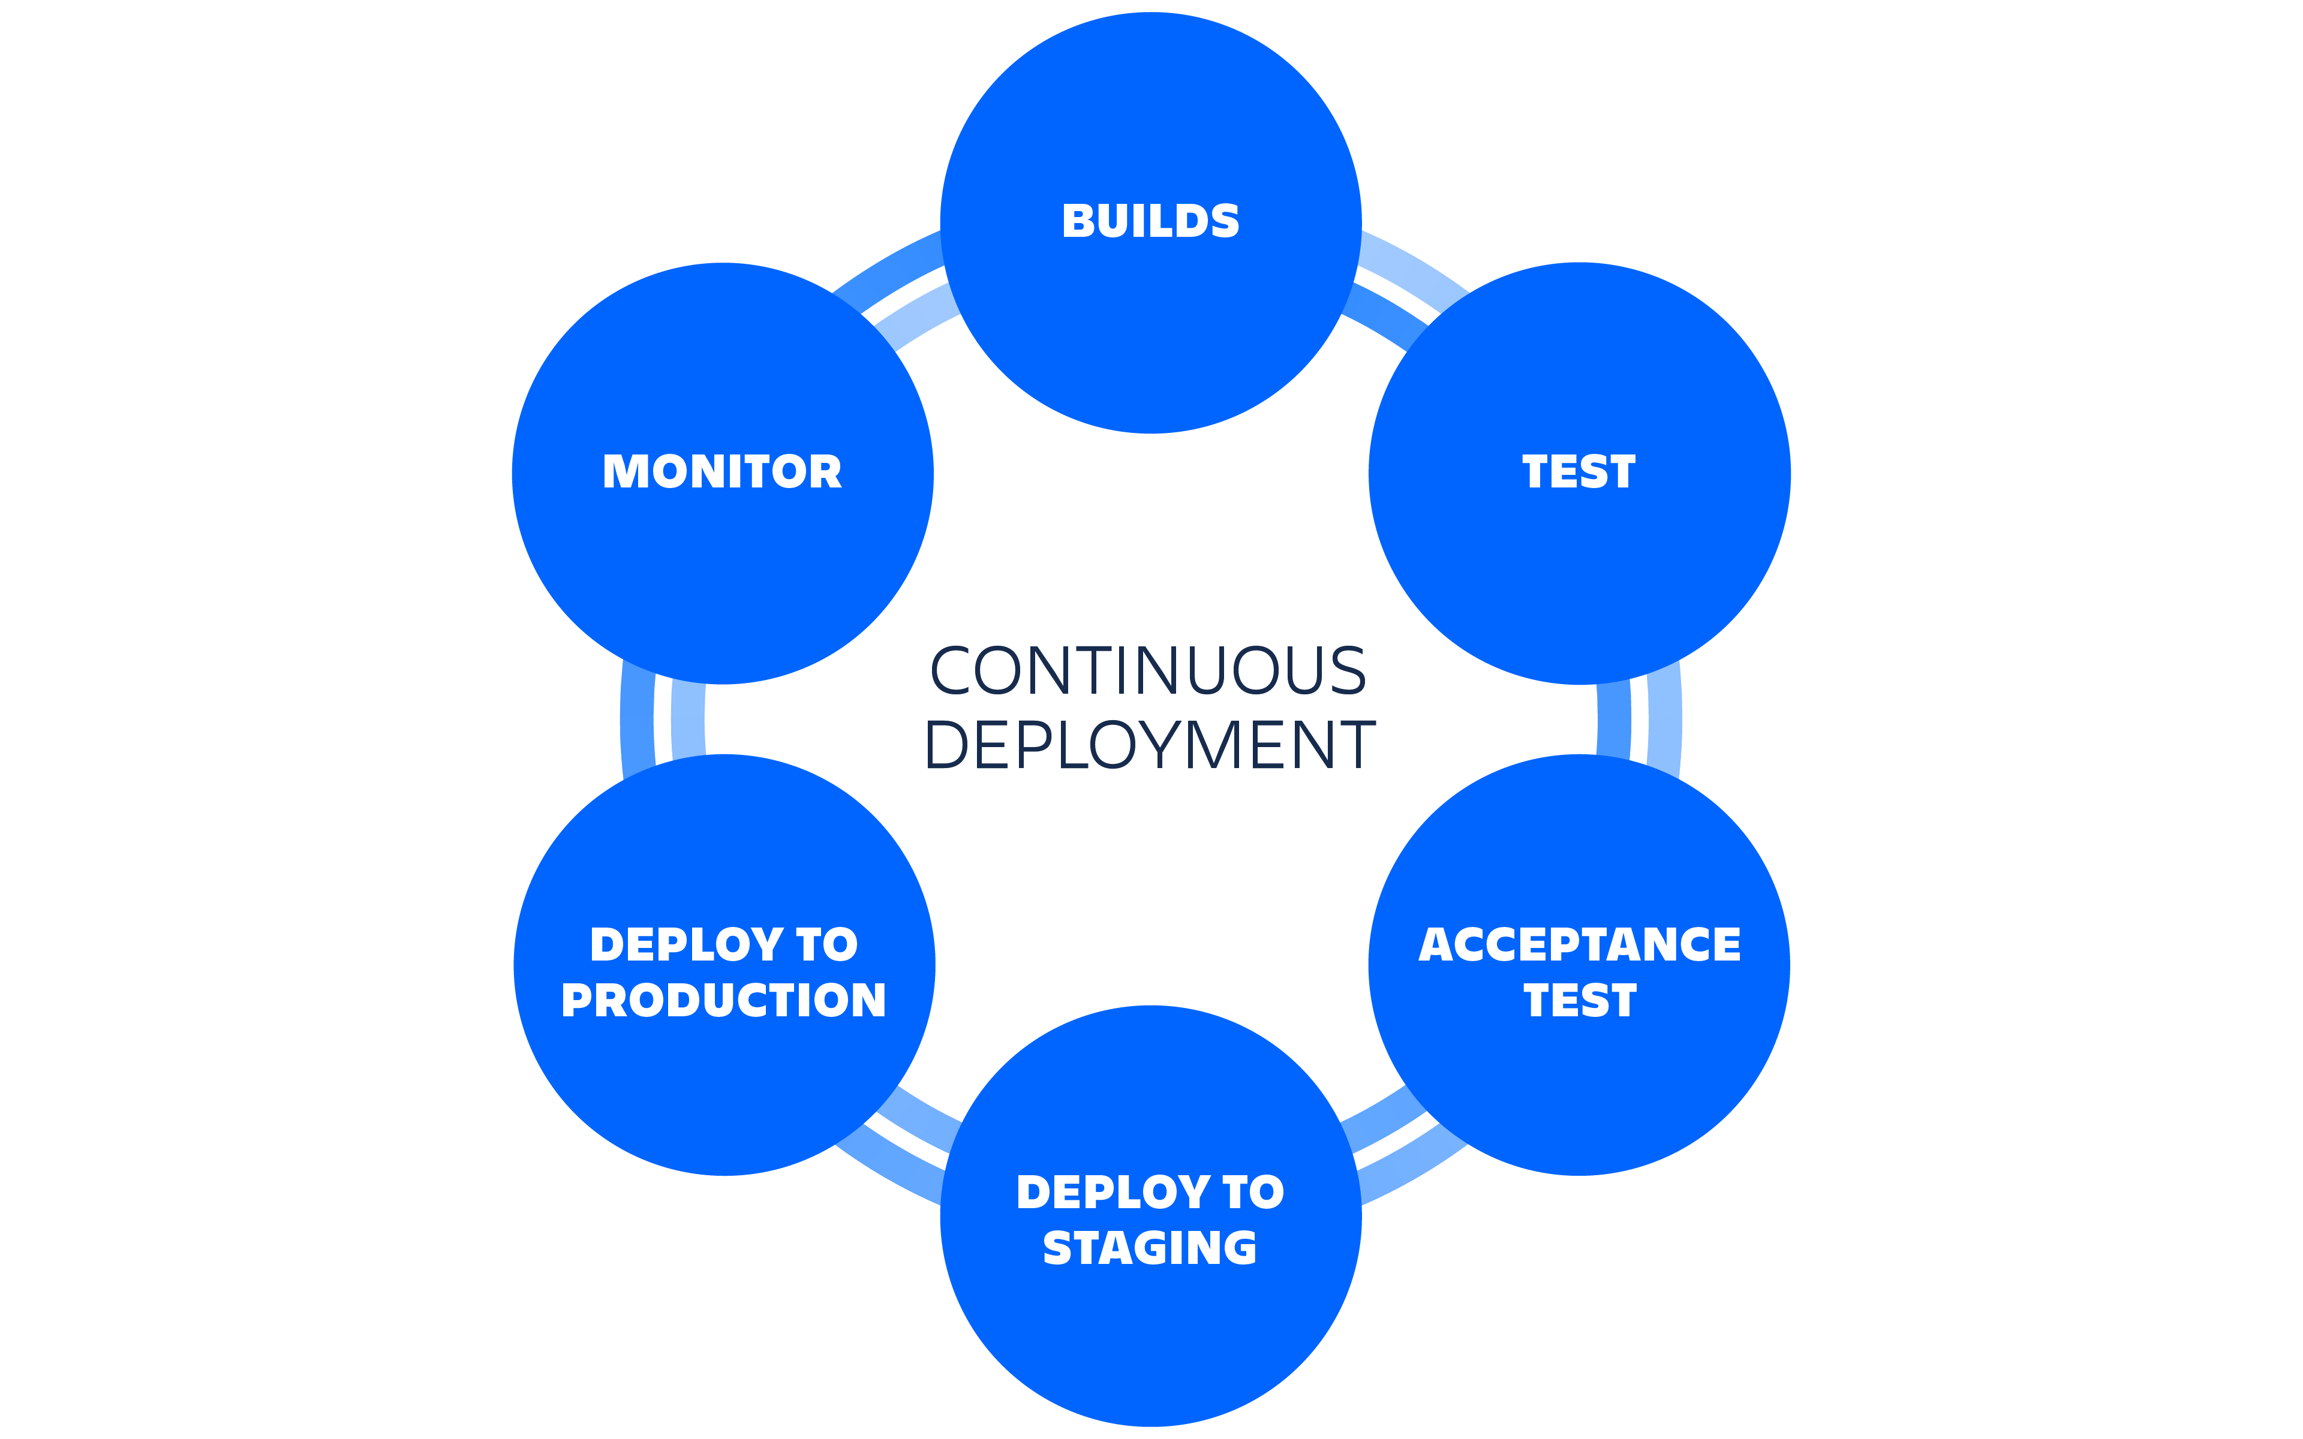
Deployment Strategy
Continuous integration and continuous deployment (CI/CD) practices will be employed for smooth updates.
The system will be deployed in the cloud for scalability and high availability.
Regular monitoring will be set in place to ensure system health and performance.
9
Notes:
Image source: https://www.atlassian.com/continuous-delivery/continuous-deployment

Slide 11
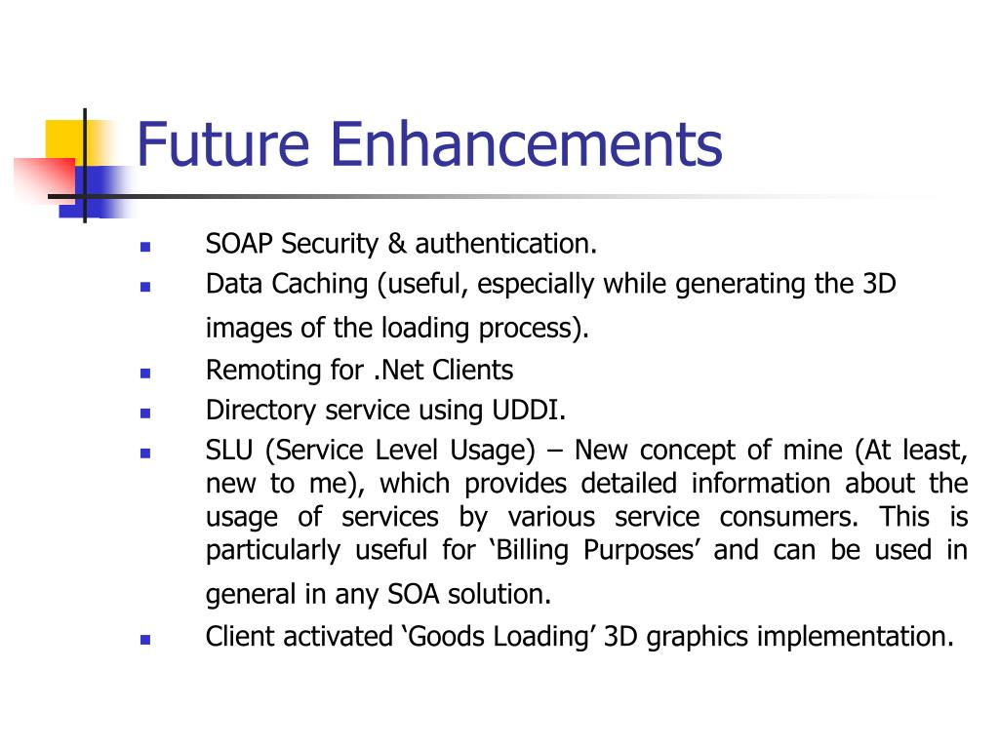
Future Enhancements and Conclusion
Future upgrades may include the addition of a mobile app to expand user accessibility.
Integration with other travel services like hotels and car rentals can enhance the overall travel experience.
The system aims to evolve continuously based on user feedback and technological advancements.
Feel free to customize any of the content or adjust the focus to better suit your specific needs!
10
Notes:
Image source: https://www.slideserve.com/gitel/presentation-project-demonstration

